Slide 1


University Institute of Engineering
DEPARTMENT OF COMPUTER SCIENCE & ENGINEERING
Bachelor of Engineering (Computer Science & Engineering)
Subject Name : Machine Learning
Subject Code: CST-316
Topic: Exploratory Data Analysis
Lecture-1.2
By : Baljeet Kaur Nagra
DISCOVER . LEARN . EMPOWER

Slide 2
Course Outcomes
CO-1:Apply the basic concept of Machine learning and statistics learning to deal with real-life Problems.
CO-2: Understand different machine learning algorithms, as well as underlying theories the behind them.
CO-3: Select and apply the appropriate machine learning algorithm to solve problems of moderate complexity
CO-4: Interpret and evaluate models generated from data.
CO-5: Optimize the models learned and report on the expected accuracy that can be attained by applying the algorithms to a real-world problem.

Slide 3
Course Objectives
To understand the history and development of Machine Learning.
To provide a comprehensive foundation to Machine Learning and Optimization methodology with applications t.
To study learning processes: supervised and unsupervised, deterministic and statistical knowledge of Machine learners, and ensemble learning
To understand modern techniques and practical trends of Machine learning.

Slide 4
Syllabus
UNIT-I
Chapter-1
Fundamentals of Machine Learning: Introduction to Machine Learning (ML), Different types of Machine Learning, Machine Learning Life Cycle: Data Discovery, Exploratory Analysis: Data Preparation, Model Planning, Model Building, Model Evaluation, Real World Case Study. Foundation of ML: ML Techniques.

Slide 5
CONTENTS
What is data?
Why use data?
What types of data exists?
Exploratory data analysis EDA
Steps for data exploration and preparation
Missing value treatment
Outlier detection and treatment
The art of Feature Engineering

Slide 6
ML Step
Data Acquisition
Data Preprocessing
Dataset split
Build your model
Validate the model/ Evaluate the model
Improvement of the model

Slide 7

What is Data?
Data is used to describe things by assigning a value to them. The values are then organized, processed, and presented within a given context so that it becomes useful.

Slide 8
Why use Data?
People turn to data because they have a story to tell or a problem to solve.
Most people start with a question, and then look to data for answers.
Exploring data without a defined question, sometimes referred to as “data mining”, can sometimes reveal interesting patterns in the data that are worth exploring.
Regardless of what leads you to look at data, thinking about your audience (your staff, supervisor, Board members, etc.) is helpful to shape the story and guide your thinking about the data.
Whenever you look at data, it is important to be open to unexpected patterns, explanations, and unusual results.
Sometimes the most interesting stories to be told with data are not the ones you set out to tell.

Slide 9
Types of data
Data is used to describe things by assigning a value to them.
The values are then organized, processed, and presented within a given context so that it becomes useful.
Data can be in different forms: qualitative and quantitative.

Slide 10
Qualitative Data
“Qualitative data” is data that uses words and descriptions.
Qualitative data can be observed but is subjective and therefore difficult to use for the purposes of making comparisons.
Descriptions of texture, taste, or an experience are all examples of qualitative data.
Qualitative data collection methods include focus groups, interviews, or open-ended items on a survey.
The questionnaires do not collect qualitative data, but it is helpful to be aware of the differentiation.
The qualitative data that describes the cup of coffee are that it has a strong taste and robust aroma.
There are two types of qualitative data: nominal and ordinal.

Slide 11
Quantitative Data
“Quantitative data” is data that is expressed with numbers.
Quantitative data is data which can be put into categories, measured, or ranked.
Length, weight, age, cost, rating scales, are all examples of quantitative data.
Quantitative data can be represented visually in graphs and tables and be statistically analysed.
The questionnaires collect quantitative data.
The quantitative data that describes the cup of coffee is that it is 12 ounces, 150 degrees Fahrenheit, and costs $1.50.
There are two types of quantitative data: discrete and continuous.

Slide 12
Nominal and Ordinal Data
Nominal data is defined as data that is used for naming or labelling variables, without any quantitative value.
It is sometimes called “named” data - a meaning coined from the word nominal.
There is usually no intrinsic ordering to nominal data.
For example, Race is a nominal variable having a number of categories, but there is no specific way to order from highest to lowest and vice versa.
Ordinal data is a type of categorical data with an order. (very intelligent, extremely intelligent)
The variables in ordinal data are listed in an ordered manner.
The ordinal variables are usually numbered, so as to indicate the order of the list.
However, the numbers are not mathematically measured or determined but are merely assigned as labels for opinions.

Slide 13
Discrete and Continuous Data
Discrete data involves round, concrete numbers that are determined by counting.
When you collect a set of round, defined numbers, they would fall in place on a graph something like those on the left.
Discrete data relates to individual, countable items.
Continuous data involves complex numbers that are measured across a specific time interval.
When you measure a certain stream of data with a complex range of results, these findings would be charted with a line as a range of data .
Continuous data relates to change over time, involving concepts that are not simply countable but require detailed measurements.

Slide 14
Exploratory Data Analysis -EDA
Exploratory Data Analysis:
1. Steps of Data Exploration and Preparation
2. Missing Value Treatment
Why missing value treatment is required ?
Why data has missing values?
Which are the methods to treat missing value ?
3. Techniques of Outlier Detection and Treatment
What is an outlier, its types and causes?
What is the impact of outliers on dataset ?
How to detect and remove outlier ?
4. The Art of Feature Engineering
What is Feature Engineering and its process ?
What is Variable Transformation and when it should be used?
What are the common methods of variable transformation ?
What is feature variable creation and its benefits ?

Slide 15
Independent
Dependant variable
fields(rows)
Predict: Target :(Non Covid/ Covid)
No of field depending
Target- Dependant
Predictors- Independent variables
Medical test(Xrays /ct scans/ mucus ….)

Slide 16
Steps of Data Exploration and Preparation
Variable Identification
Univariate Analysis
Bivariate Analysis

Slide 17
Variable Identification
First, identify Predictor (Input) and Target (output) variables. Next, identify the data type and category of the variables.
Let’s understand this step more clearly by taking an example.
Example:- Suppose, we want to predict, whether the students will play cricket or not (refer below data set). Here you need to identify predictor variables, target variable, data type of variables and category of variables.
Sno | Student_Id | Gender | Prev_Exam_Marks | Height(cm) | Weight(kg) | Play_Cricket
1 | S001 | M | 65 | 178 | 61 | 1
2 | S002 | F | 75 | 174 | 56 | 0
3 | S003 | M | 45 | 163 | 62 | 1
4 | S004 | M | 57 | 175 | 70 | 0
5 | S005 | F | 59 | 164 | 67 | 0

Slide 18
Variable Identification
Below, the variables have been defined in different category:
Type of Variable:
Predictor Variable: Gender, Prev_Exam_Marks, Height(cm), Weight(kg)
Target Variable: Play_Cricket
Data Type :
Character: Student_id, Gender
Numeric: Prev_Exam_Marks, Height(cm), Weight(kg) ,Play_Cricket
Variable Category:
Categorical(Discrete): Gender(M/F) ,Play_Cricket(0/1)
Continuous: Prev_Exam_Marks, Height(cm), Weight(kg)

Slide 19
Uni-variate Analysis
At this stage, we explore variables one by one. Method to perform uni-variate analysis will depend on whether the variable type is categorical or continuous.
Continuous Variables:- In case of continuous variables, we need to understand the central tendency and spread of the variable. These are measured using various statistical metrics visualization methods as shown below:
Central Tendency | Measure of Dispersion | Visualization Methods
Mean | Range | Histogram
Median | Quartile | Box-plot
Mode | Variance
Min | Standard Deviation
Max

Slide 20
Uni-variate Analysis
Categorical Variables:- For categorical variables, we’ll use frequency table to understand distribution of each category.
We can also read as percentage of values under each category. It can be be measured using two metrics, Count and Count% against each category.
Bar chart can be used as visualization.
 | Sno | Prev_Exam_Marks | Height(cm) | Weight(kg) | Play_Cricket
count | 5.000000 | 5.000000 | 5.00000 | 5.000000 | 5.000000
mean | 3.000000 | 60.200000 | 170.80000 | 63.200000 | 0.400000
std | 1.581139 | 11.009087 | 6.83374 | 5.449771 | 0.547723
min | 1.000000 | 45.000000 | 163.00000 | 56.000000 | 0.000000
25% | 2.000000 | 57.000000 | 164.00000 | 61.000000 | 0.000000
50% | 3.000000 | 59.000000 | 174.00000 | 62.000000 | 0.000000
75% | 4.000000 | 65.000000 | 175.00000 | 67.000000 | 1.000000
max | 5.000000 | 75.000000 | 178.00000 | 70.000000 | 1.000000

Slide 21
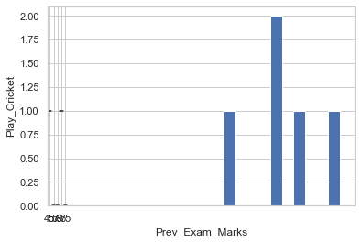
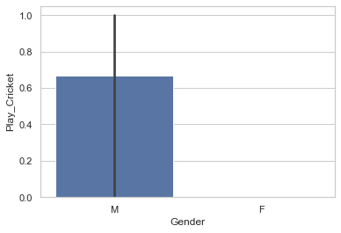
Uni-variate Analysis
HISTOGRAM
BAR CHART

Slide 22
Bi-Variate Analysis
Bi-variate Analysis finds out the relationship between two variables.
COVARIANCE
 | Prev_Exam_Marks | Height(cm) | Weight(kg)
Prev_Exam_Marks | 114.065359 | 47.104575 | 26.039216
Height(cm) | 47.104575 | 205.790850 | 30.980392
Weight(kg) | 26.039216 | 30.980392 | 42.352941

Slide 23
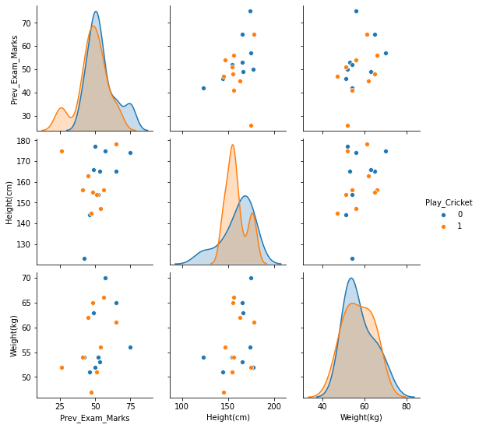
Bi-Variate Analysis
PAIR-PLOT

Slide 24
Missing Value Treatment
Why missing value treatment is required ?
Why data has missing values?
Which are the methods to treat missing value ?

Slide 25
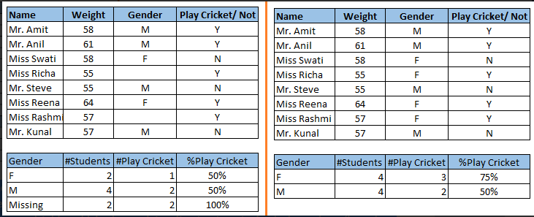
Why missing value treatment is required?
Missing data in the training data set can reduce the power / fit of a model or can lead to a biased model because we have not analysed the behavior and relationship with other variables correctly.
It can lead to wrong prediction
or classification.
In the left scenario(missing
values not treated),the inference is
that the chances of playing cricket
by males is higher than females.
In the right scenario(missing values got treated),we can see that females have higher chances of playing cricket compared to males.

Slide 26
Why data has missing values?
Data Extraction:
It is possible that there are problems with extraction process.
In such cases, we should double-check for correct data with data guardians.
Some hashing procedures can also be used to make sure data extraction is correct.
Errors at data extraction stage are typically easy to find and can be corrected easily as well.
Data collection:
These errors occur at time of data collection and are harder to correct.
They can be categorized in four types:

Slide 27
Why data has missing values?
Missing completely at random:
This is a case when the probability of missing variable is same for all observations.
Missing at random:
This is a case when variable is missing at random and missing ratio varies for different values / level of other input variables.
For example: We are collecting data for age and female has higher missing value compare to male.

Slide 28
Why data has missing values?
Missing that depends on unobserved predictors:
This is a case when the missing values are not random and are related to the unobserved input variable.
For example: In a medical study, if a particular diagnostic causes discomfort, then there is higher chance of drop out from the study. This missing value is not at random unless we have included “discomfort” as an input variable for all patients.
Missing that depends on the missing value itself:
This is a case when the probability of missing value is directly correlated with missing value itself.
For example: People with higher or lower income are likely to provide non-response to their earning.

Slide 29
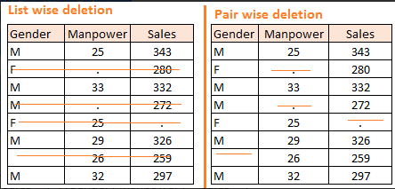
Methods to treat Missing Values
Deletion: It is of two types: List Wise Deletion and Pair Wise Deletion.
In list wise deletion, we delete observations where any of the variable is missing. Simplicity is one of the major advantage of this method, but this method reduces the power of model because it reduces the sample size.
In pair wise deletion, we perform analysis with all cases in which the variables of interest are present. Advantage of this method is, it keeps as many cases available for analysis. One of the disadvantage of this method, it uses different sample size for different variables
Deletion methods are used when the nature of missing data is “Missing completely at random” else non random missing values can bias the model output.

Slide 30
Methods to treat Missing Values
Mean/ Mode/ Median Imputation: Imputation is a method to fill in the missing values with estimated ones.
The objective is to employ known relationships that can be identified in the valid values of the data set to assist in estimating the missing values.
Mean / Mode / Median imputation is one of the most frequently used methods.
It consists of replacing the missing data for a given attribute by the mean or median (quantitative attribute) or mode (qualitative attribute) of all known values of that variable.
It can be of two types:-
Generalized Imputation: In this case, we calculate the mean or median for all non missing values of that variable then replace missing value with mean or median. Like in above table, variable “Manpower” is missing so we take average of all non missing values of “Manpower” (28.33) and then replace missing value with it.
Similar case Imputation: In this case, we calculate average for gender “Male” (29.75) and “Female” (25) individually of non missing values then replace the missing value based on gender. For “Male“, we will replace missing values of manpower with 29.75 and for “Female” with 25.

Slide 31
Methods to treat Missing Values
Prediction Model:
Prediction model is one of the sophisticated method for handling missing data.
Here, we create a predictive model to estimate values that will substitute the missing data.
In this case, we divide our data set into two sets: One set with no missing values for the variable and another one with missing values.
First data set become training data set of the model while second data set with missing values is test data set and variable with missing values is treated as target variable.
Next, we create a model to predict target variable based on other attributes of the training data set and populate missing values of test data set.
There are 2 drawbacks for this approach:
The model estimated values are usually more well-behaved than the true values
If there are no relationships with attributes in the data set and the attribute with missing values, then the model will not be precise for estimating missing values.

Slide 32
Methods to treat Missing Values
KNN Imputation: In this method of imputation, the missing values of an attribute are imputed using the given number of attributes that are most similar to the attribute whose values are missing.
The similarity of two attributes is determined using a distance function. It is also known to have certain advantage & disadvantages.
Advantages:
k-nearest neighbour can predict both qualitative & quantitative attributes
Creation of predictive model for each attribute with missing data is not required
Attributes with multiple missing values can be easily treated
Correlation structure of the data is taken into consideration

Slide 33
Methods to treat Missing Values
Disadvantage:
KNN algorithm is very time-consuming in analyzing large database. It searches through all the dataset looking for the most similar instances.
Choice of k-value is very critical. Higher value of k would include attributes which are significantly different from what we need whereas lower value of k implies missing out of significant attributes.

Slide 34
Techniques of Outlier Detection and Treatment
What is an outlier, its types and causes?
What is the impact of outliers on dataset ?
How to detect and remove outlier ?

Slide 35
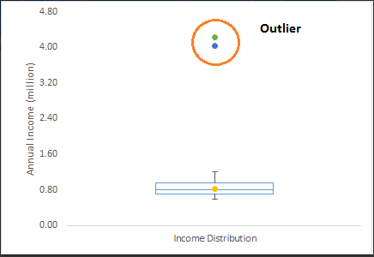
What is Outlier?
Outlier is a commonly used terminology by analysts and data scientists as it needs close attention else it can result in wildly wrong estimations.
Outlier is an observation that appears far away and diverges from an overall pattern in a sample.
Let’s take an example, we do customer profiling and find out that the average annual income of customers is $0.8 million. But, there are two customers having annual income of $4 and $4.2 million. These two customers annual income is much higher than rest of the population. These two observations will be seen as Outliers.

Slide 36
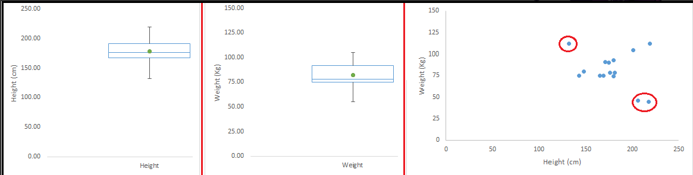
Types of Outlier
Outlier can be of two types: Univariate and Multivariate.
Univariate outliers can be found when we look at distribution of a single variable (in previous slide).
Multi-variate outliers are outliers in an n-dimensional space. In order to find them, you have to look at distributions in multi-dimensions.
Let us say we are understanding the relationship between height and weight.
Univariate (Not Present) Multivariate

Slide 37
Cause of Outliers
Causes of outliers can be classified in two broad categories:
Artificial (Error) / Non-natural
Natural.
Let’s understand various types of outliers in more detail:
Data Entry Errors:- Human errors such as errors caused during data collection, recording, or entry can cause outliers in data. For example: Annual income of a customer is $100,000. Accidentally, the data entry operator puts an additional zero in the figure. Now the income becomes $1,000,000 which is 10 times higher. Evidently, this will be the outlier value when compared with rest of the population.
Measurement Error: It is the most common source of outliers. This is caused when the measurement instrument used turns out to be faulty. For example: There are 10 weighing machines. 9 of them are correct, 1 is faulty. Weight measured by people on the faulty machine will be higher / lower than the rest of people in the group. The weights measured on faulty machine can lead to outliers.

Slide 38
Cause of Outliers
Experimental Error: For example: In a 100m sprint of 7 runners, one runner missed out on concentrating on the ‘Go’ call which caused him to start late. Hence, this caused the runner’s run time to be more than other runners. His total run time can be an outlier.
Intentional Outlier: This is commonly found in self-reported measures that involves sensitive data. For example: Teens would typically under report the amount of alcohol that they consume. Only a fraction of them would report actual value. Here actual values might look like outliers because rest of the teens are under reporting the consumption.
Data Processing Error: Whenever we perform data mining, we extract data from multiple sources. It is possible that some manipulation or extraction errors may lead to outliers in the dataset.
Sampling error: For instance, we have to measure the height of athletes. By mistake, we include a few basketball players in the sample. This inclusion is likely to cause outliers in the dataset.

Slide 39
Cause of Outliers
Natural Outlier: When an outlier is not artificial (due to error), it is a natural outlier. For instance: In my last assignment with one of the renowned insurance company, I noticed that the performance of top 50 financial advisors was far higher than rest of the population. Surprisingly, it was not due to any error. Hence, whenever we perform any data mining activity with advisors, we used to treat this segment separately.

Slide 40
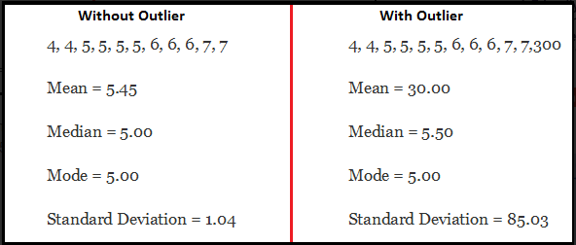
Impact of Outliers
Outliers can drastically change the results of the data analysis and statistical modeling.
There are numerous unfavourable impacts of outliers in the data set:
It increases the error variance and reduces the power of statistical tests
If the outliers are non-randomly distributed, they can decrease normality
They can bias or influence estimates that may be of substantive interest
They can also impact the basic assumption of Regression, ANOVA and other statistical model assumptions.

Slide 41
Outlier Detection
Most commonly used method to detect outliers is visualization. We use various visualization methods, like Box-plot, Histogram, Scatter Plot
Some analysts also various thumb rules to detect outliers. Some of them are:
Use capping methods. Any value which out of range of 5th and 95th percentile can be considered as outlier
Data points, three or more standard deviation away from mean are considered outlier
Bivariate and multivariate outliers are typically measured using either an index of influence or leverage, or distance.

Slide 42
Outlier Treatment
Deleting observations: We delete outlier values if it is due to data entry error, data processing error or outlier observations are very small in numbers. We can also use trimming at both ends to remove outliers.
Transforming and binning values: Transforming variables can also eliminate outliers. Natural log of a value reduces the variation caused by extreme values.
Binning is also a form of variable transformation. Decision Tree algorithm allows to deal with outliers well due to binning of variable. We can also use the process of assigning weights to different observations
Imputing: We can use mean, median, mode imputation methods. If outlier is artificial, we can go with imputing values. We can also use statistical model to predict values of outlier observation and after that we can impute it with predicted values.
Treat separately: If there are significant number of outliers, we should treat them separately in the statistical model. One of the approach is to treat both groups as two different groups and build individual model for both groups and then combine the output.

Slide 43
The Art of Feature Engineering
Features/Fields/Column Names BIG DATA(volume,variety,velocity….)
High Features→ High Dimensionality
Challenge
Computational time– Resources– Complexity
Feature Engg(relevant…)
Application(Important)-- Feature Extraction , Selection
What is Feature Engineering and its process ?
What is Variable Transformation and when it should be used?
What are the common methods of variable transformation ?
What is feature variable creation and its benefits ?

Slide 44
Feature Engineering
Feature engineering is the science (and art) of extracting more information from existing data.
You are not adding any new data here, but you are actually making the data you already have more useful.
For example, let’s say you are trying to predict foot fall in a shopping mall based on dates.
If you try and use the dates directly, you may not be able to extract meaningful insights from the data.
This is because the foot fall is less affected by the day of the month than it is by the day of the week.
Now this information about day of week is implicit in your data. You need to bring it out to make your model better.
This exercising of bringing out information from data in known as feature engineering.

Slide 45
Feature Engineering Process
You perform feature engineering once you have completed the first 5 steps in data exploration – Variable Identification, Univariate, Bivariate Analysis, Missing Values Imputation and Outliers Treatment.
Feature engineering itself can be divided in 2 steps:
Variable transformation.
Variable / Feature creation.
These two techniques are vital in data exploration and have a remarkable impact on the power of prediction.

Slide 46
Variable Transformation
In data modelling, transformation refers to the replacement of a variable by a function.
For instance, replacing a variable x by the square / cube root or logarithm x is a transformation.
In other words, transformation is a process that changes the distribution or relationship of a variable with others.

Slide 47
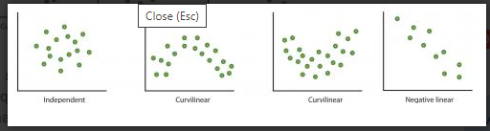
When to use Variable Transformation
When we want to change the scale of a variable or standardize the values of a variable for better understanding. While this transformation is a must if you have data in different scales, this transformation does not change the shape of the variable distribution
When we can transform complex non-linear relationships into linear relationships. Existence of a linear relationship between variables is easier to comprehend compared to a non-linear or curved relation.
Transformation helps us to convert a non-linear relation into linear relation.
Scatter plot can be used to find the relationship between two continuous variables.
These transformations also improve the prediction.
Log transformation is one of the commonly used transformation technique used in these situations

Slide 48
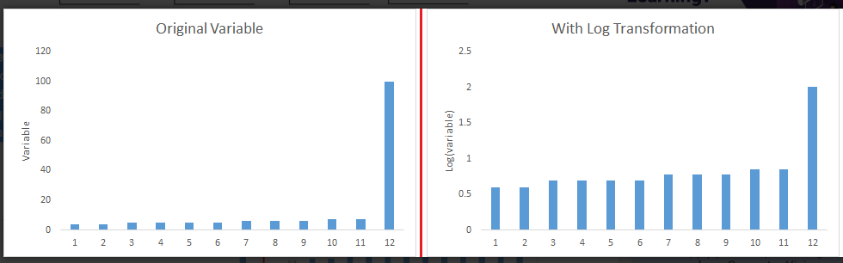
When to use Variable Transformation
Symmetric distribution is preferred over skewed distribution as it is easier to interpret and generate inferences.
Some modeling techniques requires normal distribution of variables. So, whenever we have a skewed distribution, we can use transformations which reduce skewness.
For right skewed distribution, we take square / cube root or logarithm of variable.
For left skewed, we take square / cube or exponential of variables

Slide 49
When to use Variable Transformation
Variable Transformation is also done from an implementation point of view (Human involvement).
In one of the project on employee performance, It is found that age has direct correlation with performance of the employee i.e. higher the age, better the performance.
From an implementation stand point, launching age based progamme might present implementation challenge.
However, categorizing the sales agents in three age group buckets of <30 years, 30-45 years and >45 and then formulating three different strategies for each group is a judicious approach.
This categorization technique is known as Binning of Variables.

Slide 50
Methods for Variable Transformation
Logarithm: Log of a variable is a common transformation method used to change the shape of distribution of the variable on a distribution plot. It is generally used for reducing right skewness of variables. Though, It can’t be applied to zero or negative values as well.
Square / Cube root: The square and cube root of a variable has a sound effect on variable distribution. However, it is not as significant as logarithmic transformation. Cube root has its own advantage. It can be applied to negative values including zero. Square root can be applied to positive values including zero.
Binning: It is used to categorize variables. It is performed on original values, percentile or frequency. Decision of categorization technique is based on business understanding. For example, we can categorize income in three categories, namely: High, Average and Low. We can also perform co-variate binning which depends on the value of more than one variables.

Slide 51
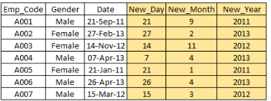
Variable Creation and its benefits
Feature / Variable creation is a process to generate a new variables / features based on existing variable(s).
For example, say, we have date(dd-mm-yy) as an input variable in a data set.
We can generate new variables like day, month, year, week, weekday that may have better relationship with target variable.
This step is used to highlight the hidden relationship in a variable:

Slide 52
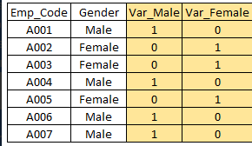
Variable Creation and its benefits
Creating derived variables: This refers to creating new variables from existing variable(s) using set of functions or different methods.
Let a dataset which has variable age has missing values. To predict missing values, we used the salutation (Master, Mr, Miss, Mrs) of name as a new variable.
Creating dummy/indicator variables: One of the most common application of dummy variable is to convert categorical variable into numerical variables.
It is useful to take categorical variable as a predictor in statistical models.
Let’s take a variable ‘gender’. We can produce two variables, namely,
“Var_Male” with values 1 (Male) and 0 (No male) and
“Var_Female” with values 1 (Female) and 0 (No Female).

Slide 53
References
Books and Journals
Understanding Machine Learning: From Theory to Algorithms by Shai Shalev-Shwartz and Shai Ben-David-Cambridge University Press 2014
Introduction to machine Learning – the Wikipedia Guide by Osman Omer.
Video Link-
https://www.youtube.com/watch?v=9f-GarcDY58
https://www.youtube.com/watch?v=GwIo3gDZCVQ
Web Link-
https://www.analyticsvidhya.com/blog/2016/01/guide-data-exploration/
https://towardsdatascience.com/exploratory-data-analysis-8fc1cb20fd15
https://towardsdatascience.com/a-gentle-introduction-to-exploratory-data-analysis-f11d843b8184

Slide 54

THANK YOU

